Slide 1

We are links in a chain of hope: developing the peer support worker role in an NHS early intervention in psychosis service
Alison Walsh
PerCIE Student Rep
Apprentice Registered Nurse, Cheshire and Wirral Partnership NHS FT
Student Nurse, BN Hons(mental health), University of Chester
Former Peer Support Worker
Alison.Walsh11@nhs.net

Slide 2



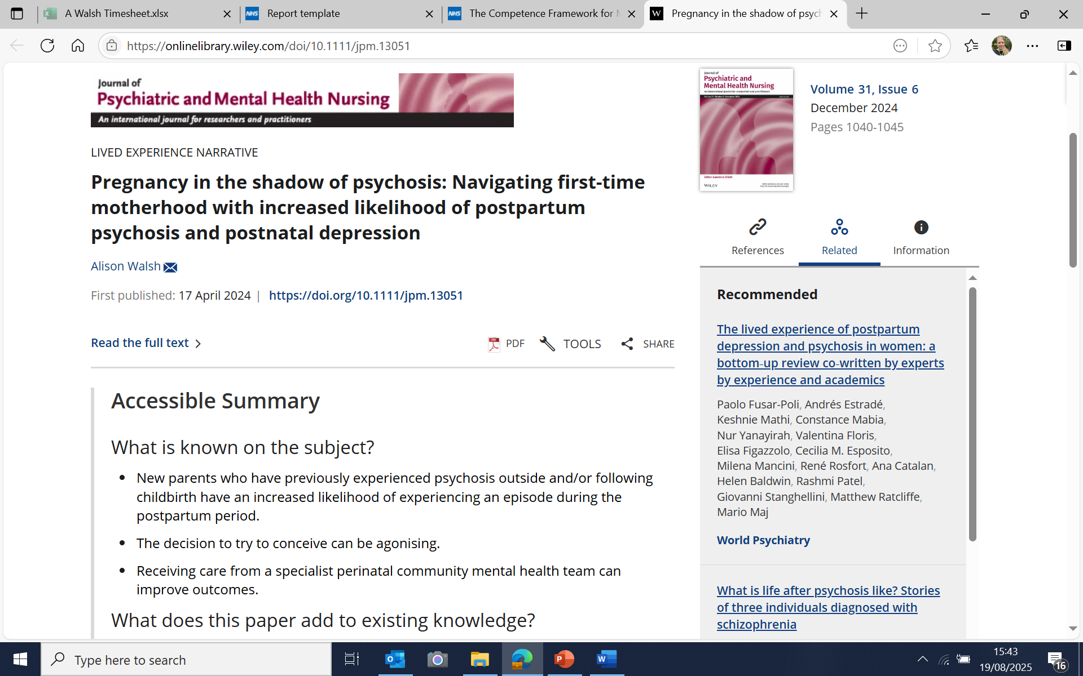
My Story
Sources: Action on Postpartum Psychosis, www.app-network.org; Walsh, 2024;2025

Slide 3

What is intentional peer support? How does it fit with person centred care?
Concerned here with roles that explicitly use principles of Intentional Peer Support
Approach developed by Sherry Mead in 1990s
Guiding principles social justice and social change
Trauma informed
Source: www.intentionalpeersupport.org

Slide 4
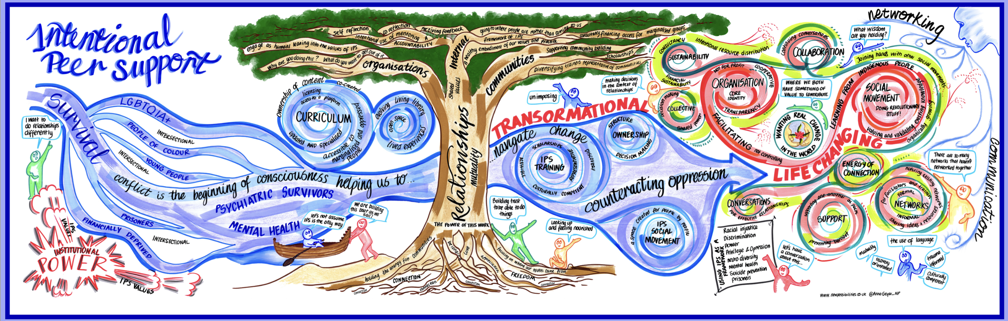

Our heritage is rooted in activism
Civil rights movement
Disability rights movement and intersectionality
‘Nothing about us without us’
Survivor movement: National Survivor User Network, the Hearing Voices Approach, Mad Pride, Mad Studies, networks and groups on social media
Sources: www.intentionalpeersupport.org

Slide 5
Peer support workers in health and social care
Traditionally part of voluntary, community, social enterprise sector (VCSE)
In 2019 NHS Long Term Plan proposed expansion of the role in NHS Trusts to 4,730 peer support workers over 5 years
Both directly employed and in partnership with VCSE
Sources: Health Education England, 2020a

Slide 6
Headcount figures
2015
48 workers
2016
111 workers
2017
153 workers
2019
862 workers
2023
1 018 (mean 21 workers/median 9/highest concentration in London)
2025
Plateauing? Danger of being seen as ‘not critical to care’
Sources: Health Education England, 2020a; Oxford Health NHS FT, 2023

Slide 7
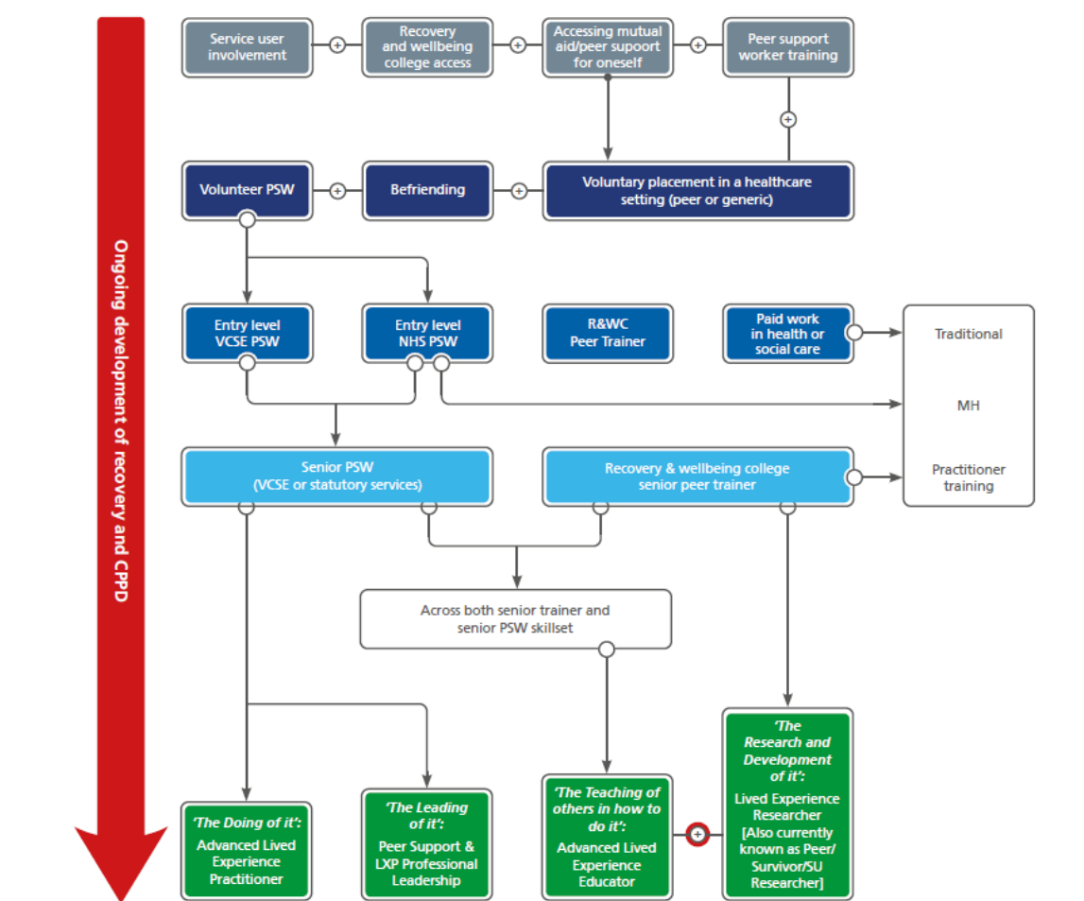
Peer support workers in the lived experience workforce
Source: Ball and Skinner, 2021

Slide 8
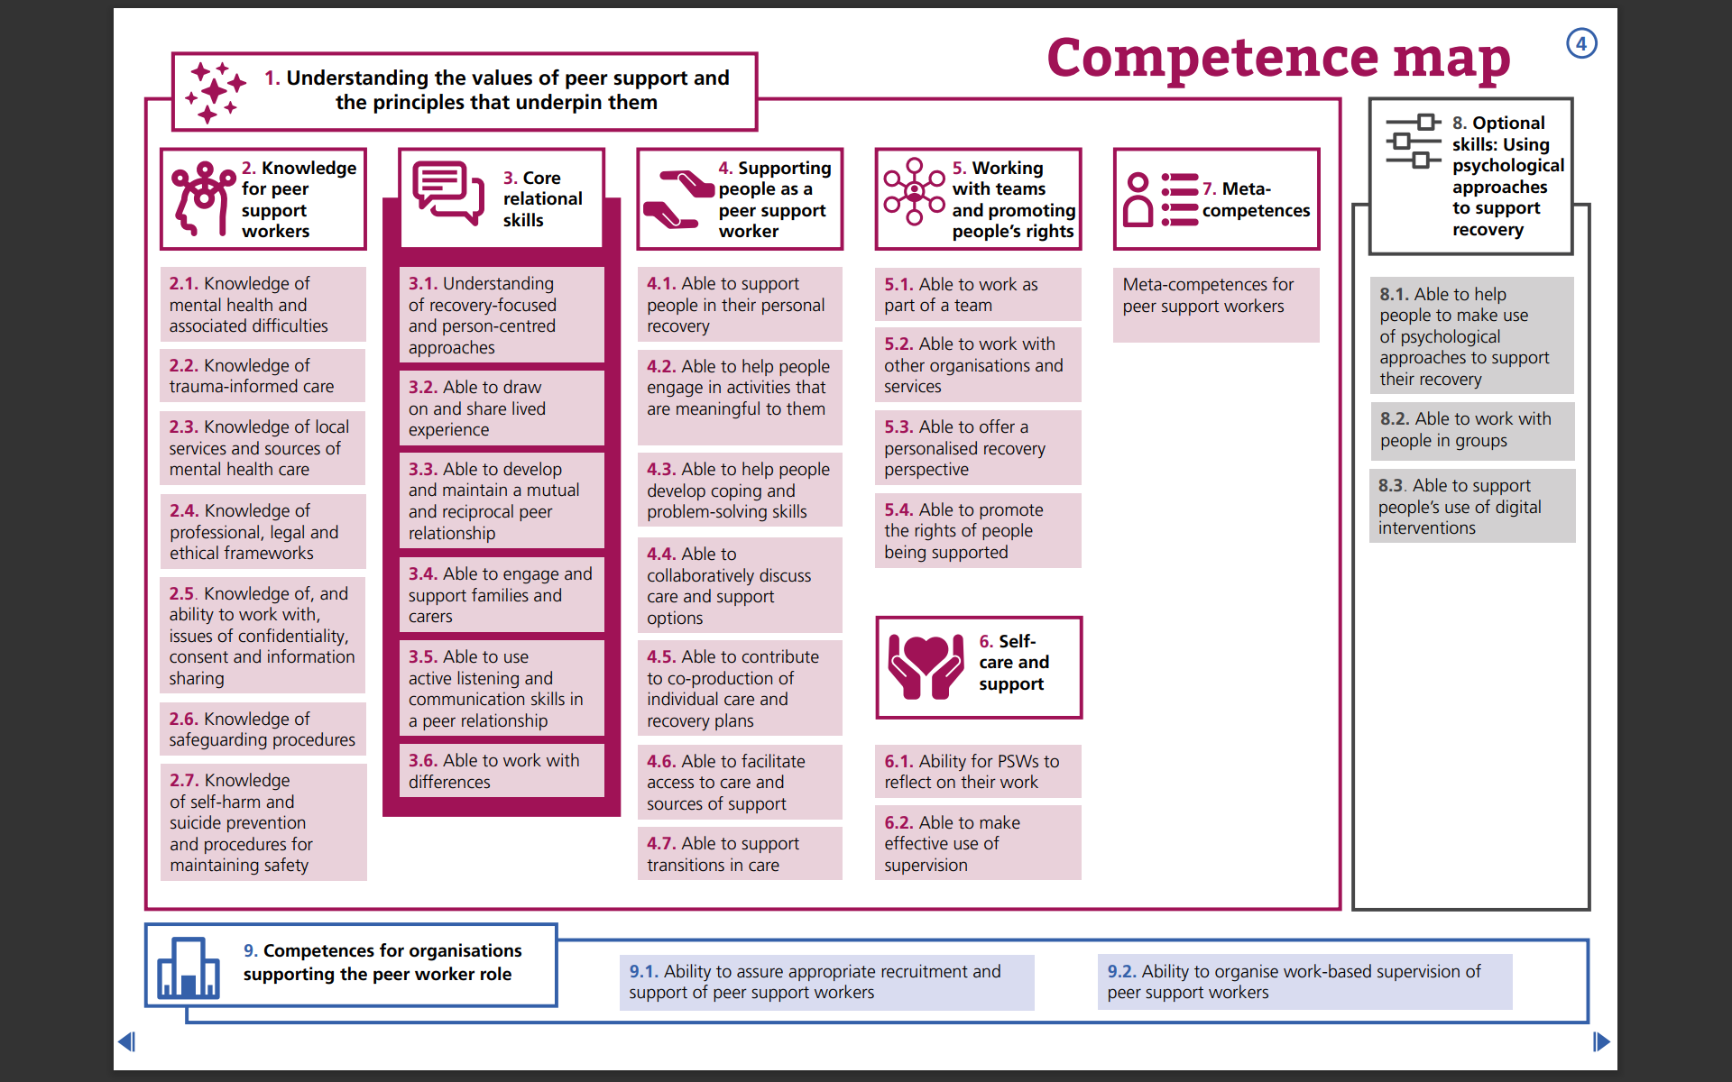

Peer Support Worker Competencies
Source: Health Education England, 2020b

Slide 9
Developing the peer support worker role in an Early Intervention in Psychosis Service
Blank canvas
Offer hope about prospects for ‘recovery’
Often first person individual/family has met with psychosis experience
Normalise talking about psychosis
(Hearing Voices Group)
Everyday activities (goals based)
Navigation of the service
Support person to expand social network
Link between clinical team, recovery college and VCSE organisations
Co-facilitate Open Dialogue meetings (completed PGCert/1 year training)

Slide 10
How can we support peer support workers?
Get to know peer support workers and how they define their role
Be aware of the ‘clinical gaze’ and role creep
Approach contribution of non-clinical roles with open mindedness

Slide 11
RECCOMENDATIONS TO Senior Leaders AND ORGANISATIONS:
Honor reasonable adjustments
Develop specific roles (in addition to making lived experience a desired criteria when recruiting established roles)
Allow flexibility in the development of the role when in post
Avoid employment of single peer support workers in a team?
Provide resilience based supervision with senior lived experience worker or ally clinical colleague
Offer parity of pay and esteem
Develop career pathway (majority of workforce is B3 or B4)
Commission research/facilitate sharing of peer support practice
Incorporate learning about the role of peer support workers in nurse education

Slide 12
References / further reading
Ball, M. & Skinner, S. (2021). Raising the glass ceiling: considering a career pathway for peer support workers. https://www.hee.nhs.uk/sites/default/files/documents/Raising%20the%20glass%20ceiling_considering%20a%20career%20pathway%20for%20peer%20support%20workers%20-%20Final%20%281%29.pdf
Cooper, R.E., Saunders, K.R.K., Greenburgh, A. et al. (2024) The effectiveness, implementation, and experiences of peer support approaches for mental health: a systematic umbrella review. BMC Medicine, 22 (72) https://doi.org/10.1186/s12916-024-03260-y
Harris, H. & Soklaridis, S. (nd). Reflections on peer support: visions of opportunity for 2030. Imroc. Retrieved 26 August, 2025, from https://www.imroc.org/publications/reflections-on-peer-support-visions-of-opportunity-for-2030
Health Education England (2020a). National Workforce Stocktake of Mental Health Peer Support Workers in NHS Trusts. https://www.hee.nhs.uk/sites/default/files/documents/NHS%20Peer%20Support%20Worker%20Benchmarking%20report.pdf
Health Education England (2020b). The competence framework for mental health peer support workers. Health Education England, https://www.hee.nhs.uk/sites/default/files/documents/The%20Competence%20Framework%20for%20MH%20PSWs%20-%20Part%202%20-%20Full%20listing%20of%20the%20competences.pdf
Oxford Health NHS Foundation Trust (2023). Peer Support Workers Census 2023. NHS Benchmarking Network. https://www.google.com/url?sa=t&source=web&rct=j&opi=89978449&url=https://ppn.nhs.uk/south-east/resource-library/newsletter-documents/483-peer-support-workers-2023-census-bespoke-submission-report/file&ved=2ahUKEwiNr7jcxbWPAxU1WUEAHXJFJ90QFnoECBoQAQ&usg=AOvVaw0rW8HvbnofH1APafSHBAqP
Owen, D., Watson, E. & Repper, J. (2024). The role of lived experience within health and social care systems. Imroc Briefing Paper 26, https://static1.squarespace.com/static/65e873c27971d37984653be0/t/66bb960ec5f023459dd35bf4/1723569686714/Imroc+Briefing+Paper+26.pdf
Walsh, A. (2024). Pregnancy in the shadow of psychosis: navigating first time motherhood with a higher likelihood of experiencing postpartum psychosis and postnatal depression. Journal of Psychiatric and Mental Health Nursing, 31 (6), 104-1045. https://doi.org/10.1111/jpm.13051
Walsh, A. (2025). Confronting the shadow: from ontological shock to perspectivism and posttraumatic growth after psychotic depression. Psychosis: Psychological, Social and Integrative Approaches. https://www.tandfonline.com/doi/full/10.1080/17522439.2025.2521854?src=
Watson, E. (2024). Supervision for peer support workers. Imroc briefing paper 25. https://static1.squarespace.com/static/65e873c27971d37984653be0/t/66b344308706157585716563/1723024432598/ImROC+Briefing+Paper+25+%283%29.pdf

